Slide 1
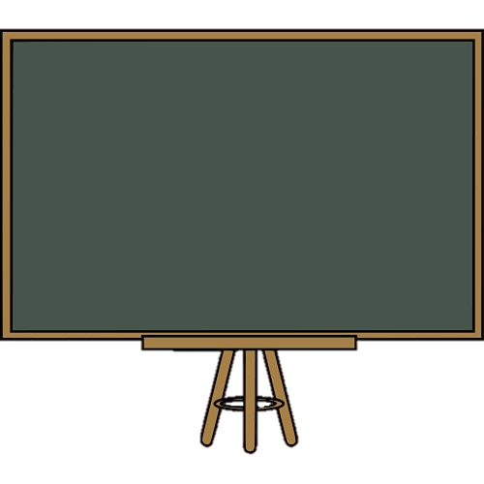
Past Simple
Regular verbs

Slide 2
We use the past simple to talk about things that happened in the past.

Slide 3
Time expressions:
Yesterday
last week/month/year
a year ago
the day/week before
in 2010…

Slide 4
Affirmative
I | played
He, she, it | played
We, you, they | played

Slide 5
Spelling rules
Infinitive + ed/d | visit – visited love – loved
Vowel + y: ed | enjoy – enjoyed
Consonant + y: ied | study – studied
One-syllable verb 1 vowel + 1consonant: Double consonant + ed | stop – stopped bat – batted
Two-syllable with stress on second syllable and ending with a single consonant: Double consonant + ed | permit – permitted commit – committed

Slide 6
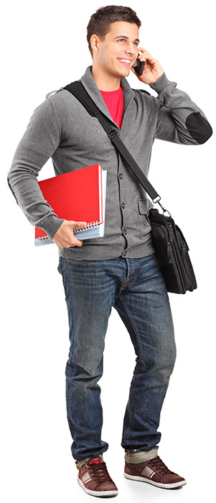

Tom phoned his best friend.

Slide 7
Negative
Subject + didn’t + infinitive
I | didn’t | play work Watch
He, she, it | didn’t
We, you, they | didn’t

Slide 8
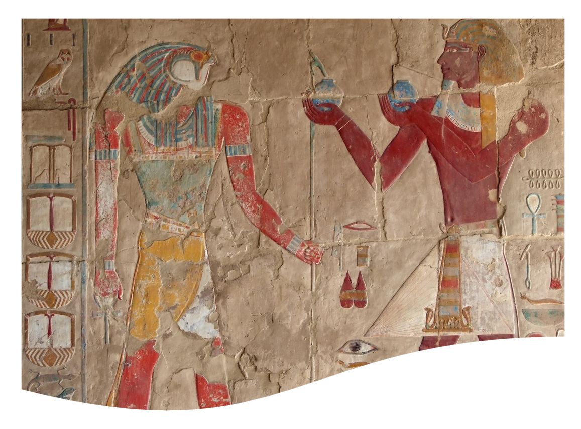
They didn’t study for the Maths test.
They studied for the History test.

Slide 9
Interrogative
Did + subject + infinitive
Did | I | play? work? like?
Did | he, she, it
Did | we, you, they

Slide 10
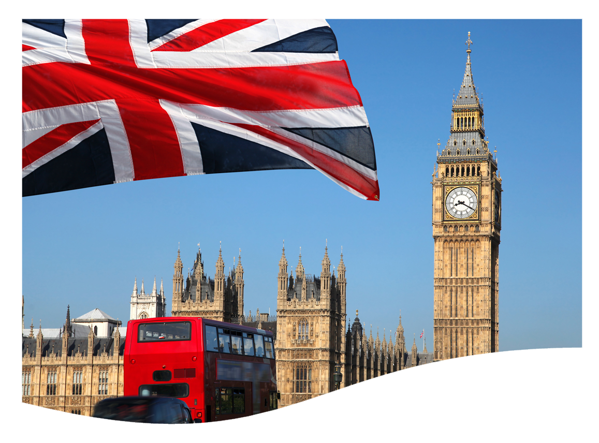
Did they visit London last year?
Yes, they did.

Slide 11

Did Kate walk to school?
No, she didn’t

Slide 12

?
Grammar practice
Look at the pictures and make true sentences. Use the past simple.

Slide 13
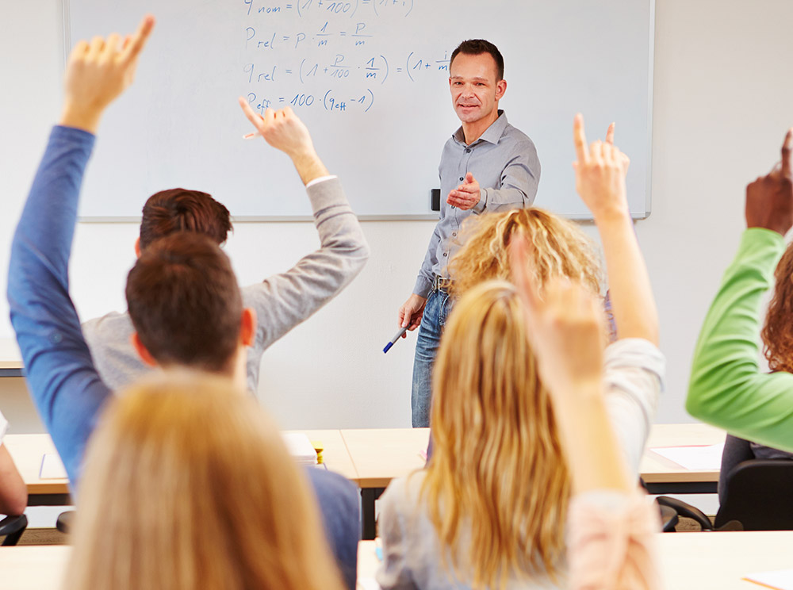
Follow the exemple.
They / ask a question.
Did they ask a question?
Yes, they did. They asked a question.
No, they didn’t.

Slide 14

Emily / visit / the Coliseum in Rome.
Did Emily visit the Coliseum in Rome?
Yes, she did. She visited it.

Slide 15
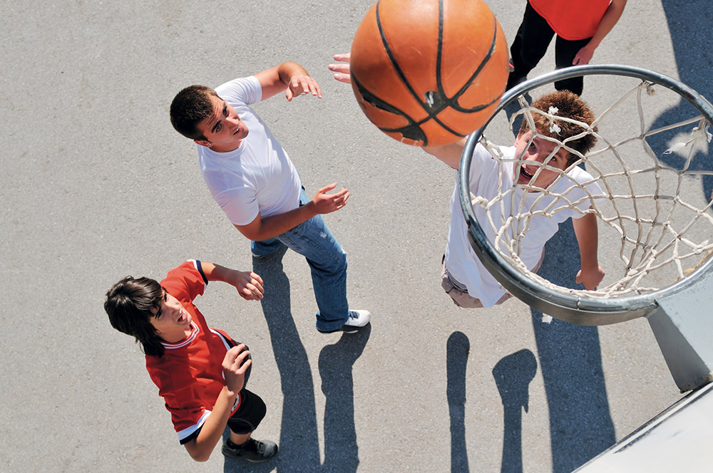
They / play / football in the morning.
Did they play handball in the morning?
No, they didn’t. They played basketball.

Slide 16

We / dance / a lot last Saturday.
Did we party a lot last Saturday?
Yes, we did. We danced a lot.

Slide 17
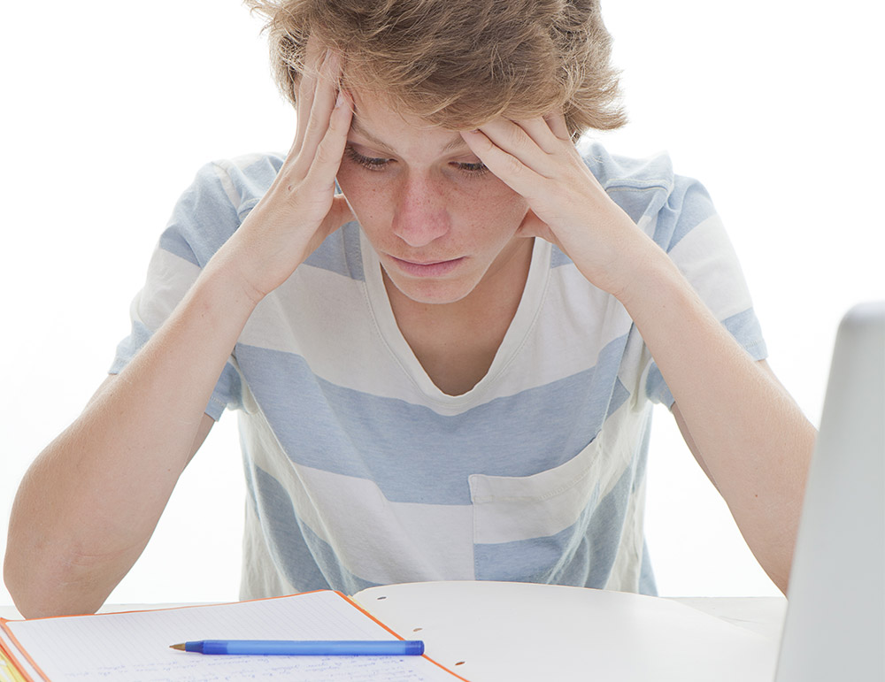
Paul/ study / hard
Did Bill study hard?
Yes, he did. He studied hard.

Slide 18
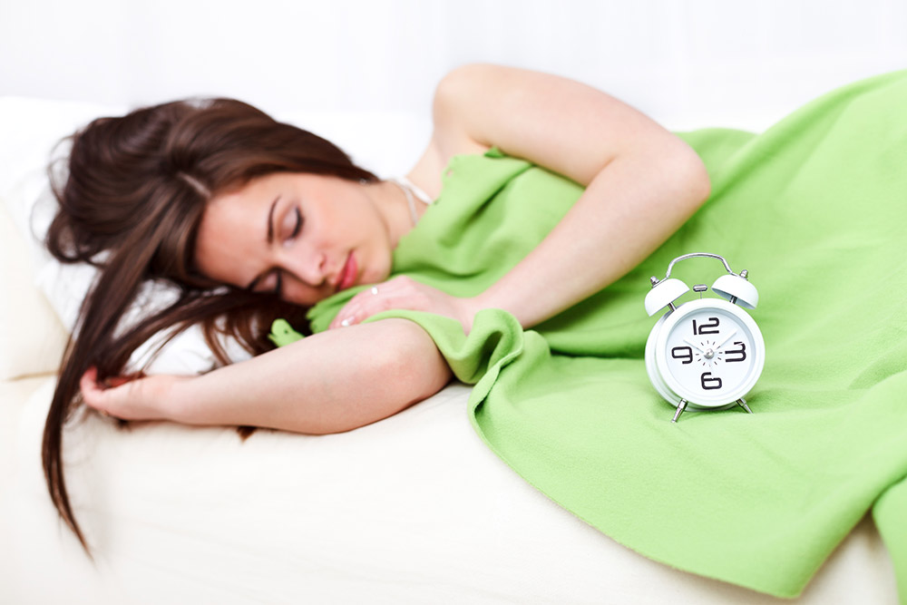
Sarah/ stay / in bed late
Did Daisy stay in bed late?
Yes, she did. She stayed in bed late.

Slide 19
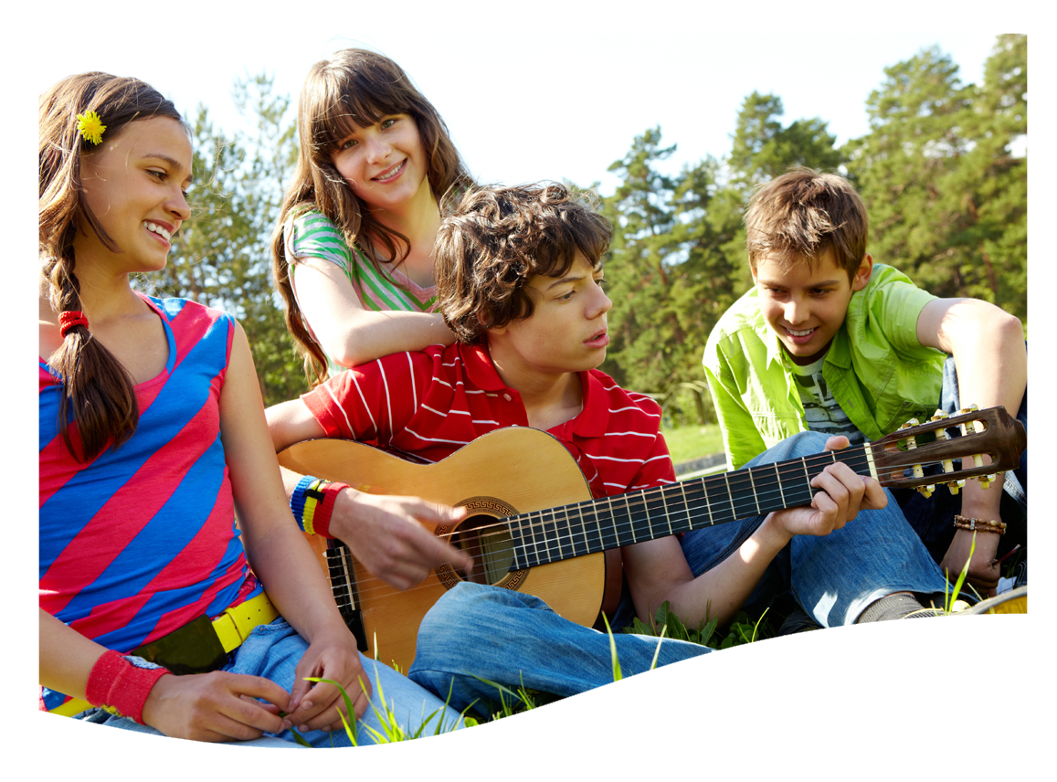
My cousin / play / the piano
Did my cousin play the piano?
No, he didn’t. He played the guitar.

Slide 20

Henry / smile / at me
Did Henry smile at you?
Yes, he did. He smiled at me.

